Slide 1
LoRa and Meshtastic
Inexpensive Radio for a Wide Area and its application for EmComm.

Slide 2
What is it?
Key Features
Long Range: Connects devices up to 9–15 miles in rural areas and penetrates deep indoor or dense urban environments.
Low Power: Uses minimal energy, allowing battery or solar operation for years.
Unlicensed Bands: Operates on public Industrial, Scientific, and Medical (ISM) radio bands (such as 915 MHz in the US or 433 MHz in Europe/Australia) without an operator license.
Low Bandwidth: Transfers data at speeds between 300 and 50,000 bits per second, making it ideal for sensors and text, not video.

Slide 3
How is it used?
Popular Applications
Meshtastic: An open-source, off-grid decentralized mesh network that uses LoRa radios for text messaging and GPS sharing via mobile phones.
LoRaWAN: A wide-area network protocol used to connect battery-operated Internet of Things (IoT) sensors to the internet via gateways.
LoRa APRS: An amateur radio tool used to broadcast real-time telemetry and positional data without traditional voice repeaters.

Slide 4
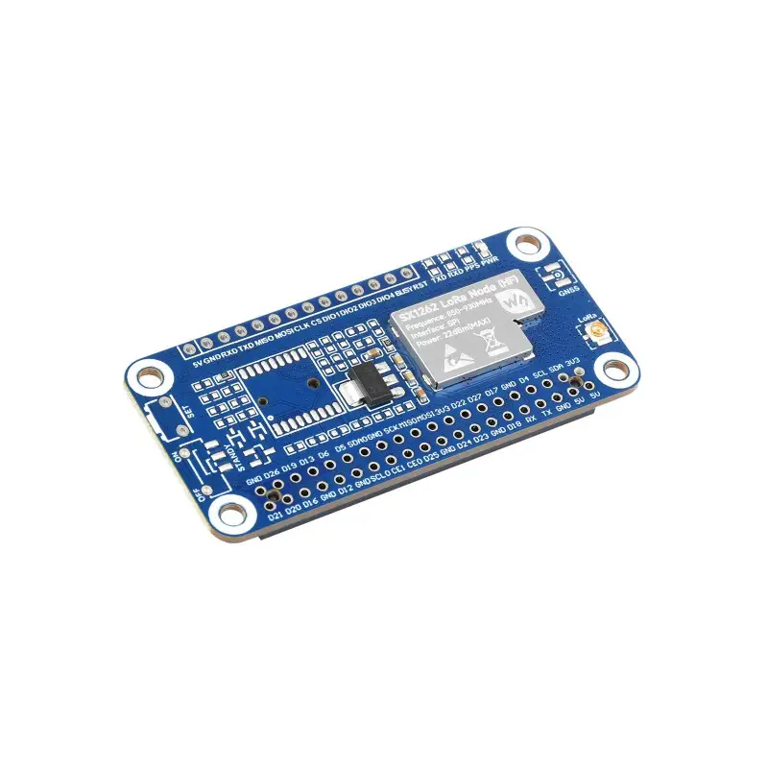
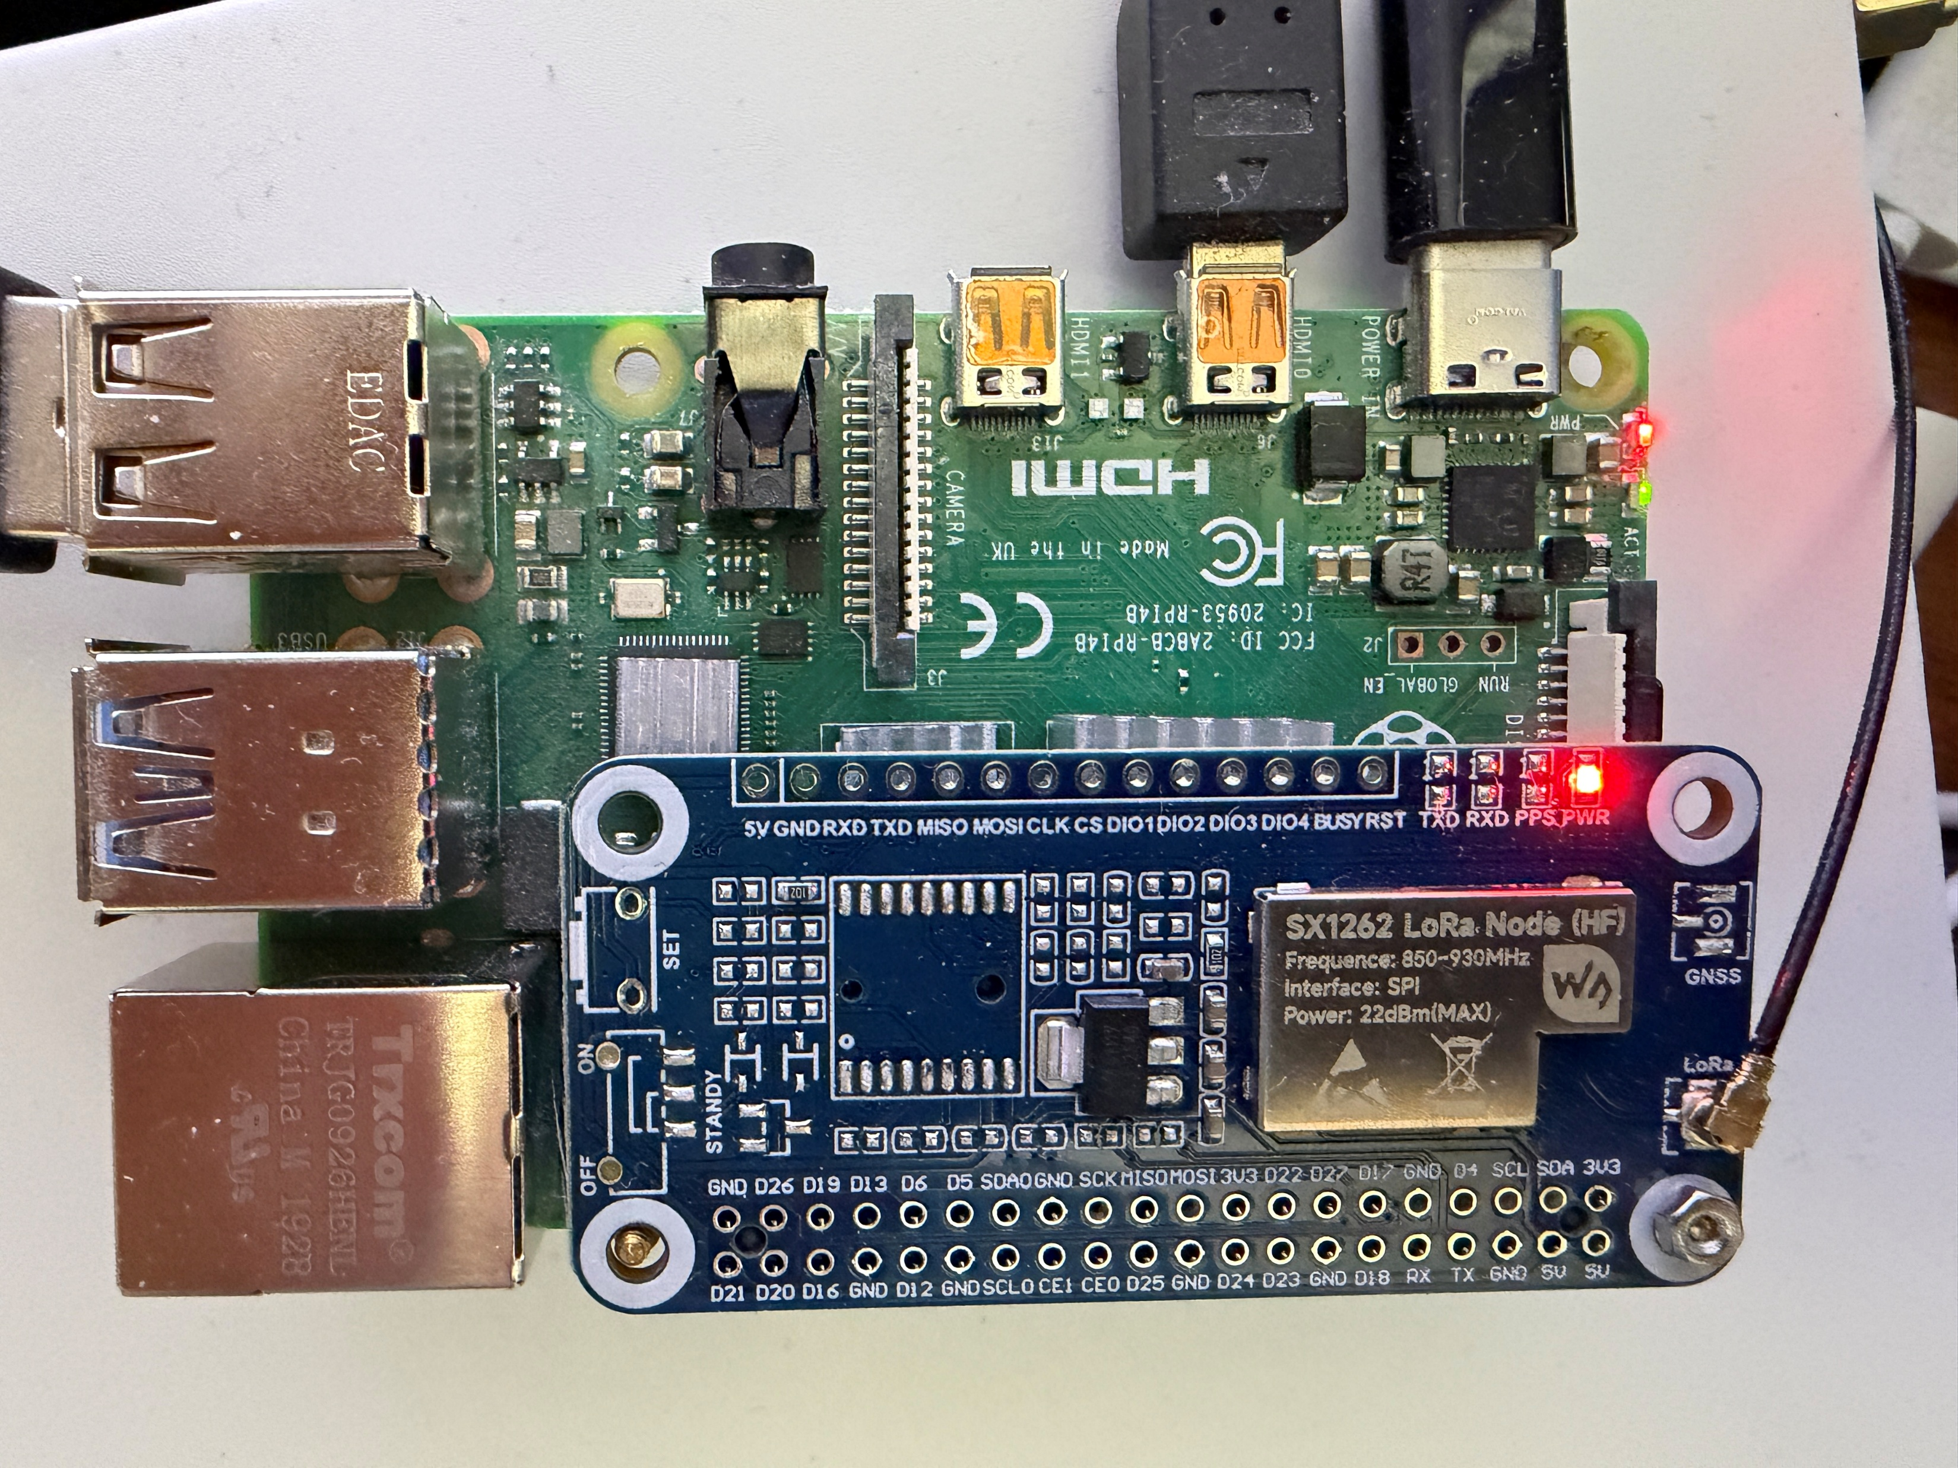
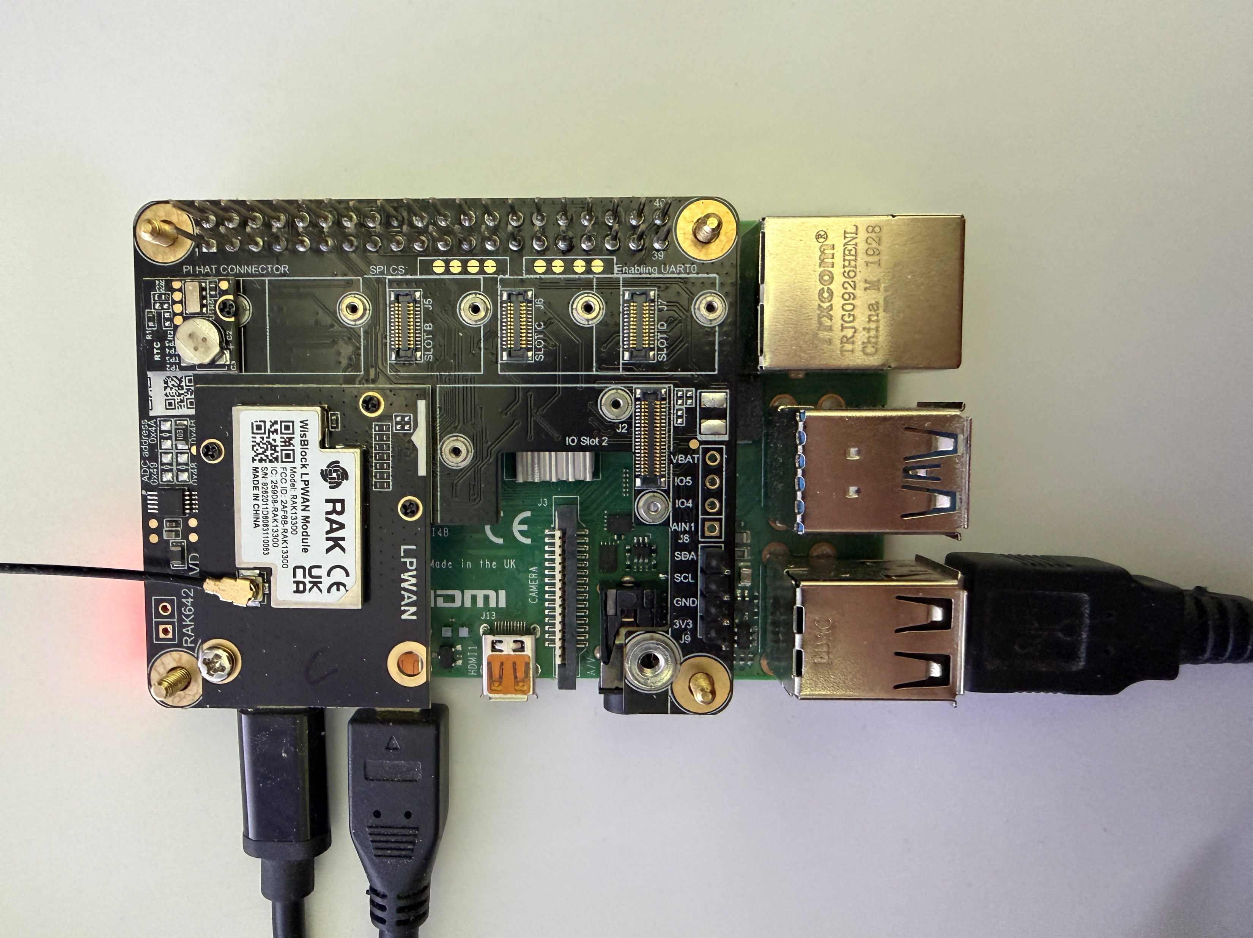
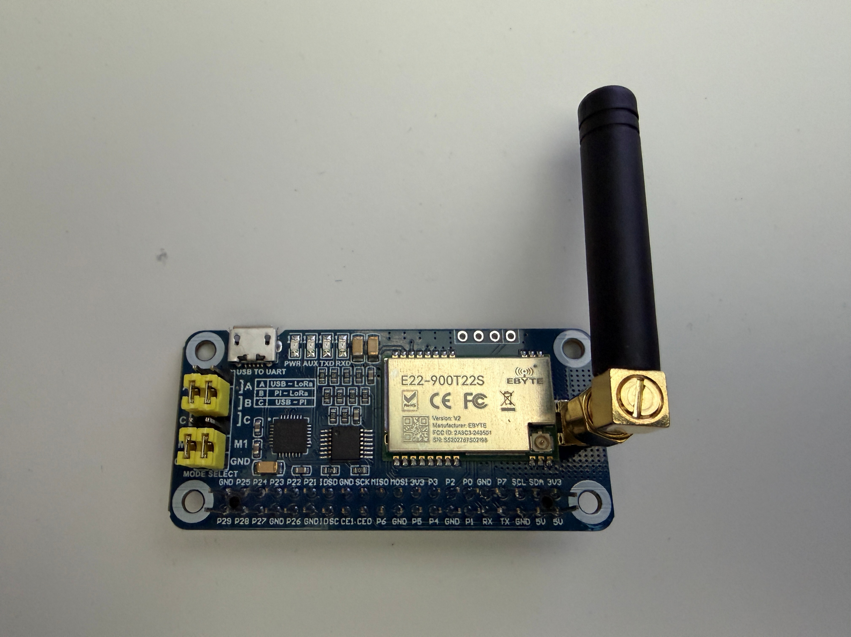
LoRa Equipment
Equipment can come in various packages.
Cheap HAT or accessory boards for Raspberry Pi
Notes:
Waveshare SX1262 LoRaWAN

Slide 5
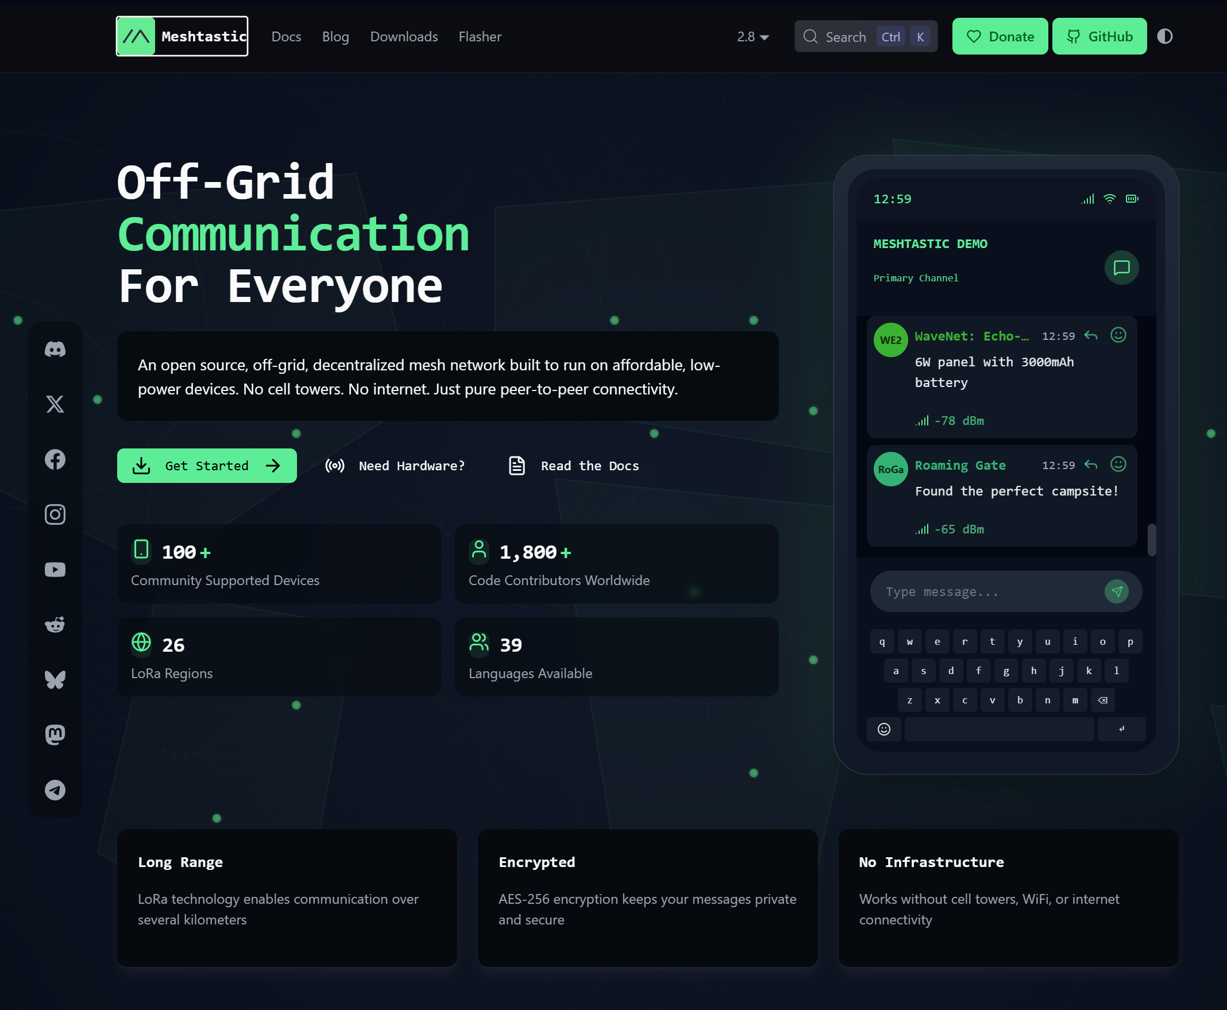

What is Meshtastic?
Meshtastic is an open-source, off-grid communication system that lets you send text messages and share data using small radio devices without needing cell service or the internet.
Meshtastic.org

Slide 6
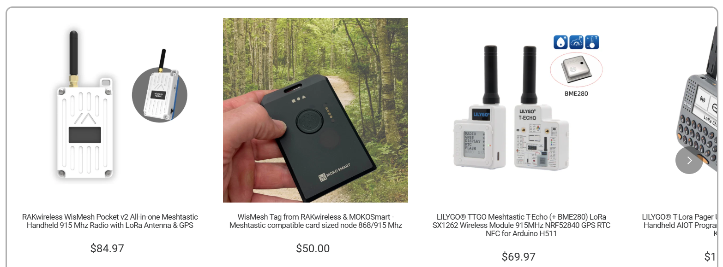
Meshtastic Equipment
Dedicated Meshtastic equipment is available.

Slide 7
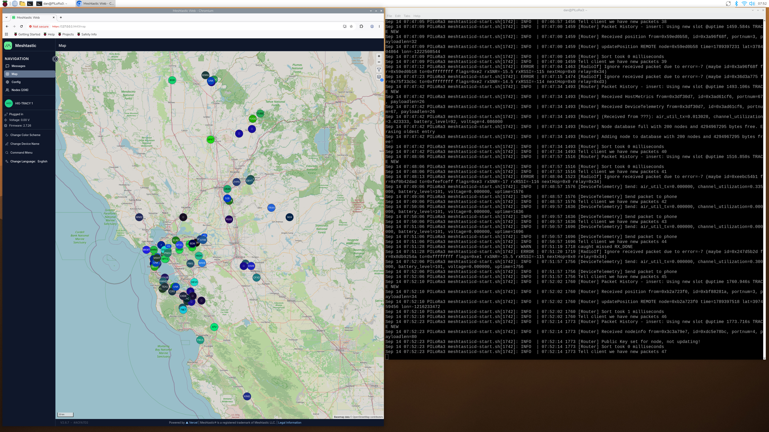
What I have tried.
Waveshare SX1262 LoRaWAN board and installed meshtasticd service on a Raspberry Pi 4B.

Slide 8
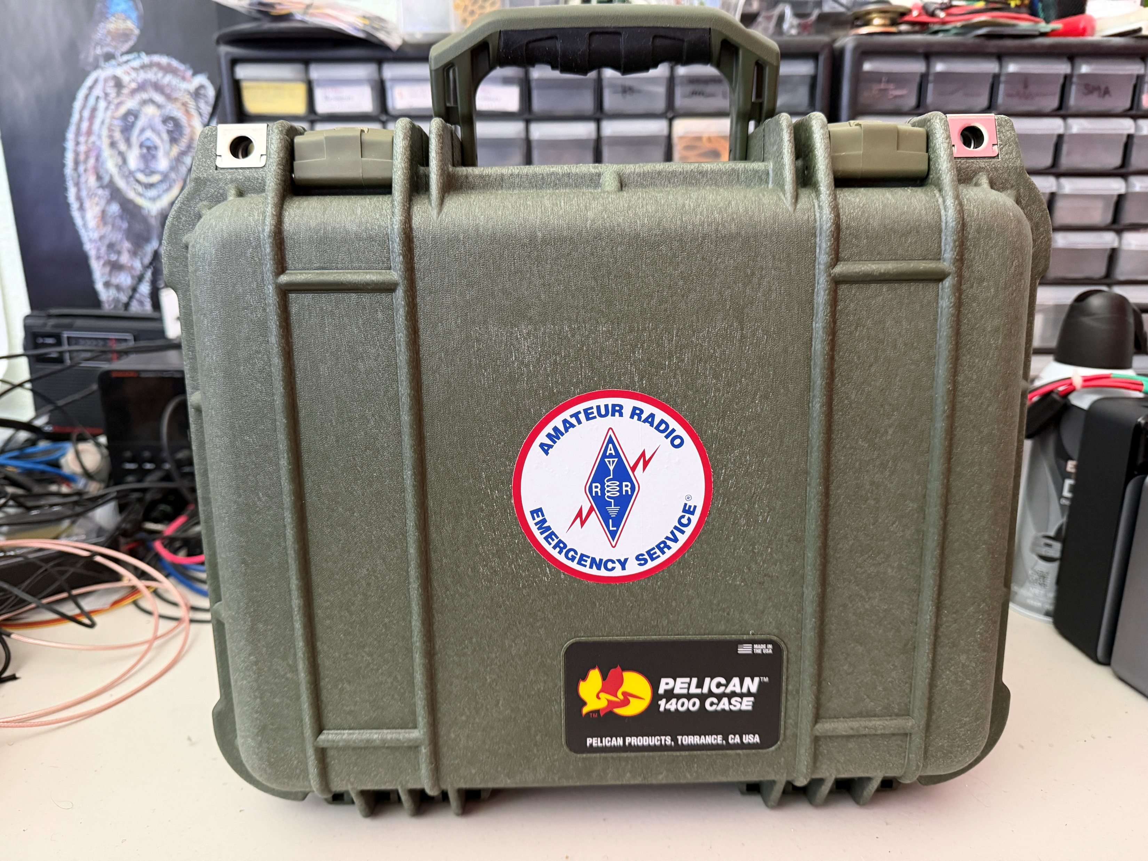
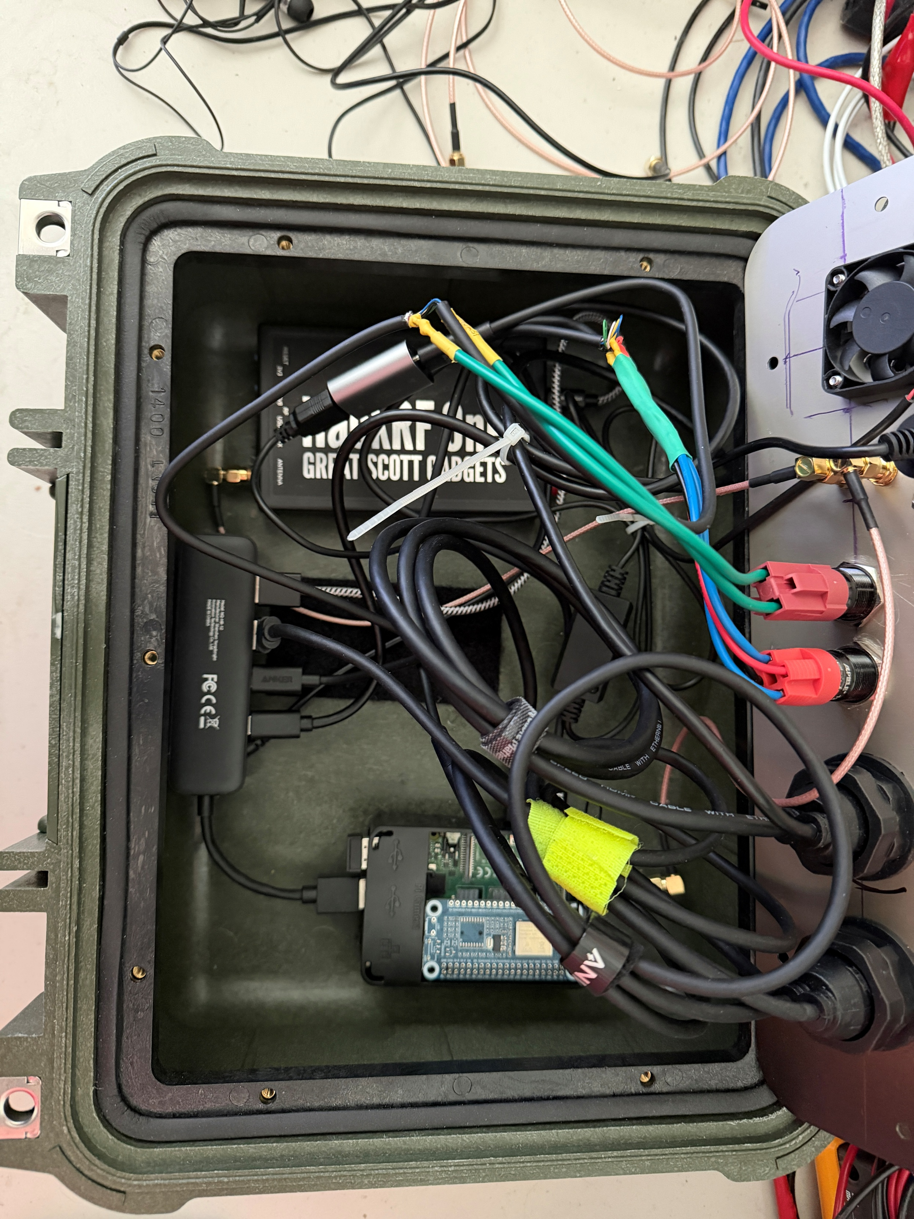
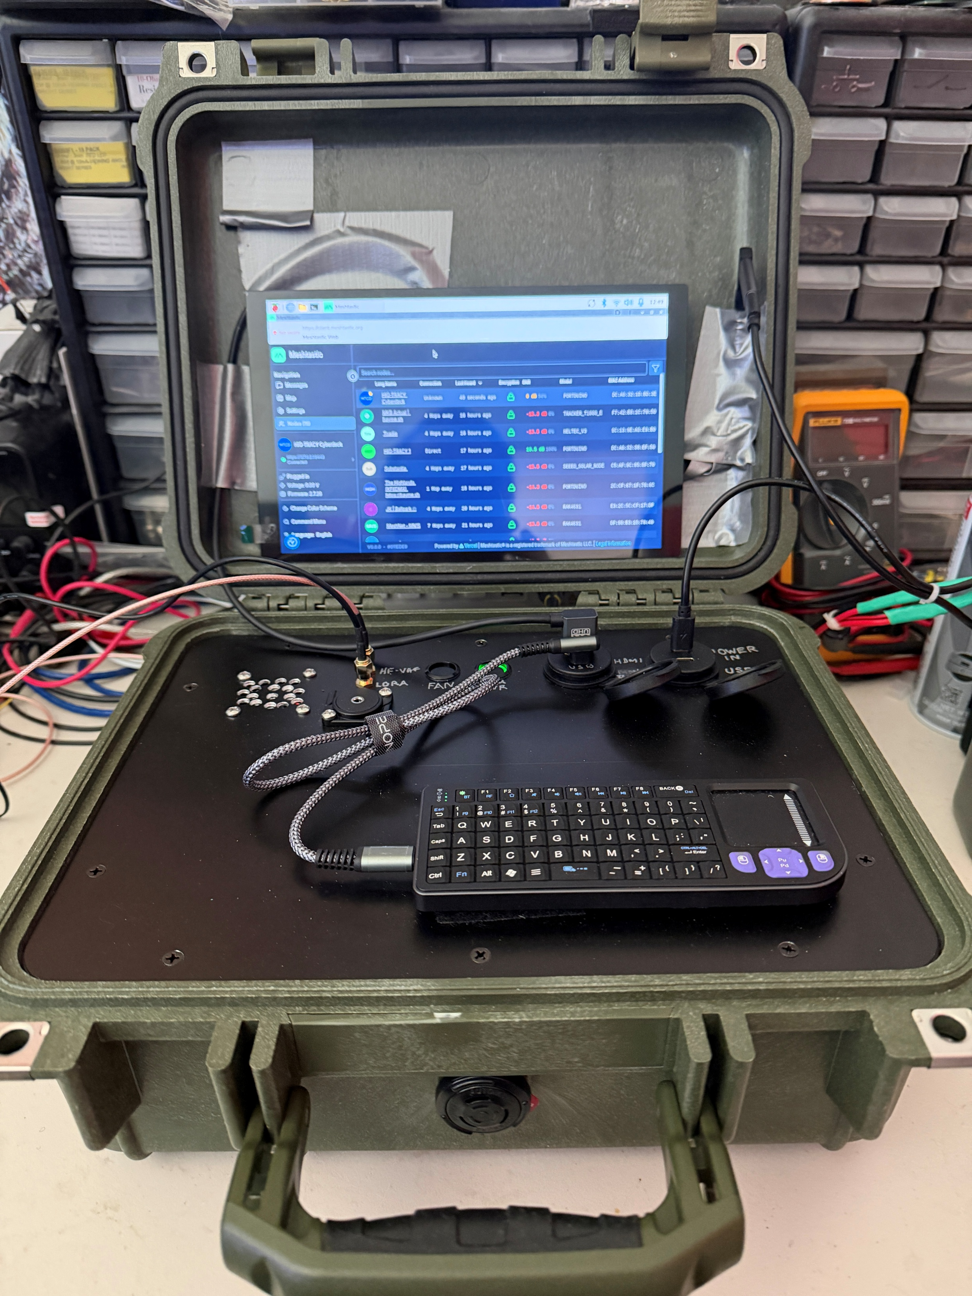
…and also…
Built a cyberdeck with a Hack One RF (SDR) and a LoRa.
Hack One RF allows the monitoring of bandwidths by RTL-SDR software. LoRa as already discussed and Raspberry Pi can be hooked up to a radio for use with WSJT-X, JSCALL, FLDIGI, and Packet.
Notes:
Hack One RF allows the monitoring of bandwidths by RTL-SDR software. LoRa as already discussed and Raspberry Pi can be hooked up to a radio for use with WSJT-X, JSCALL, or FLDIGI.

Slide 9
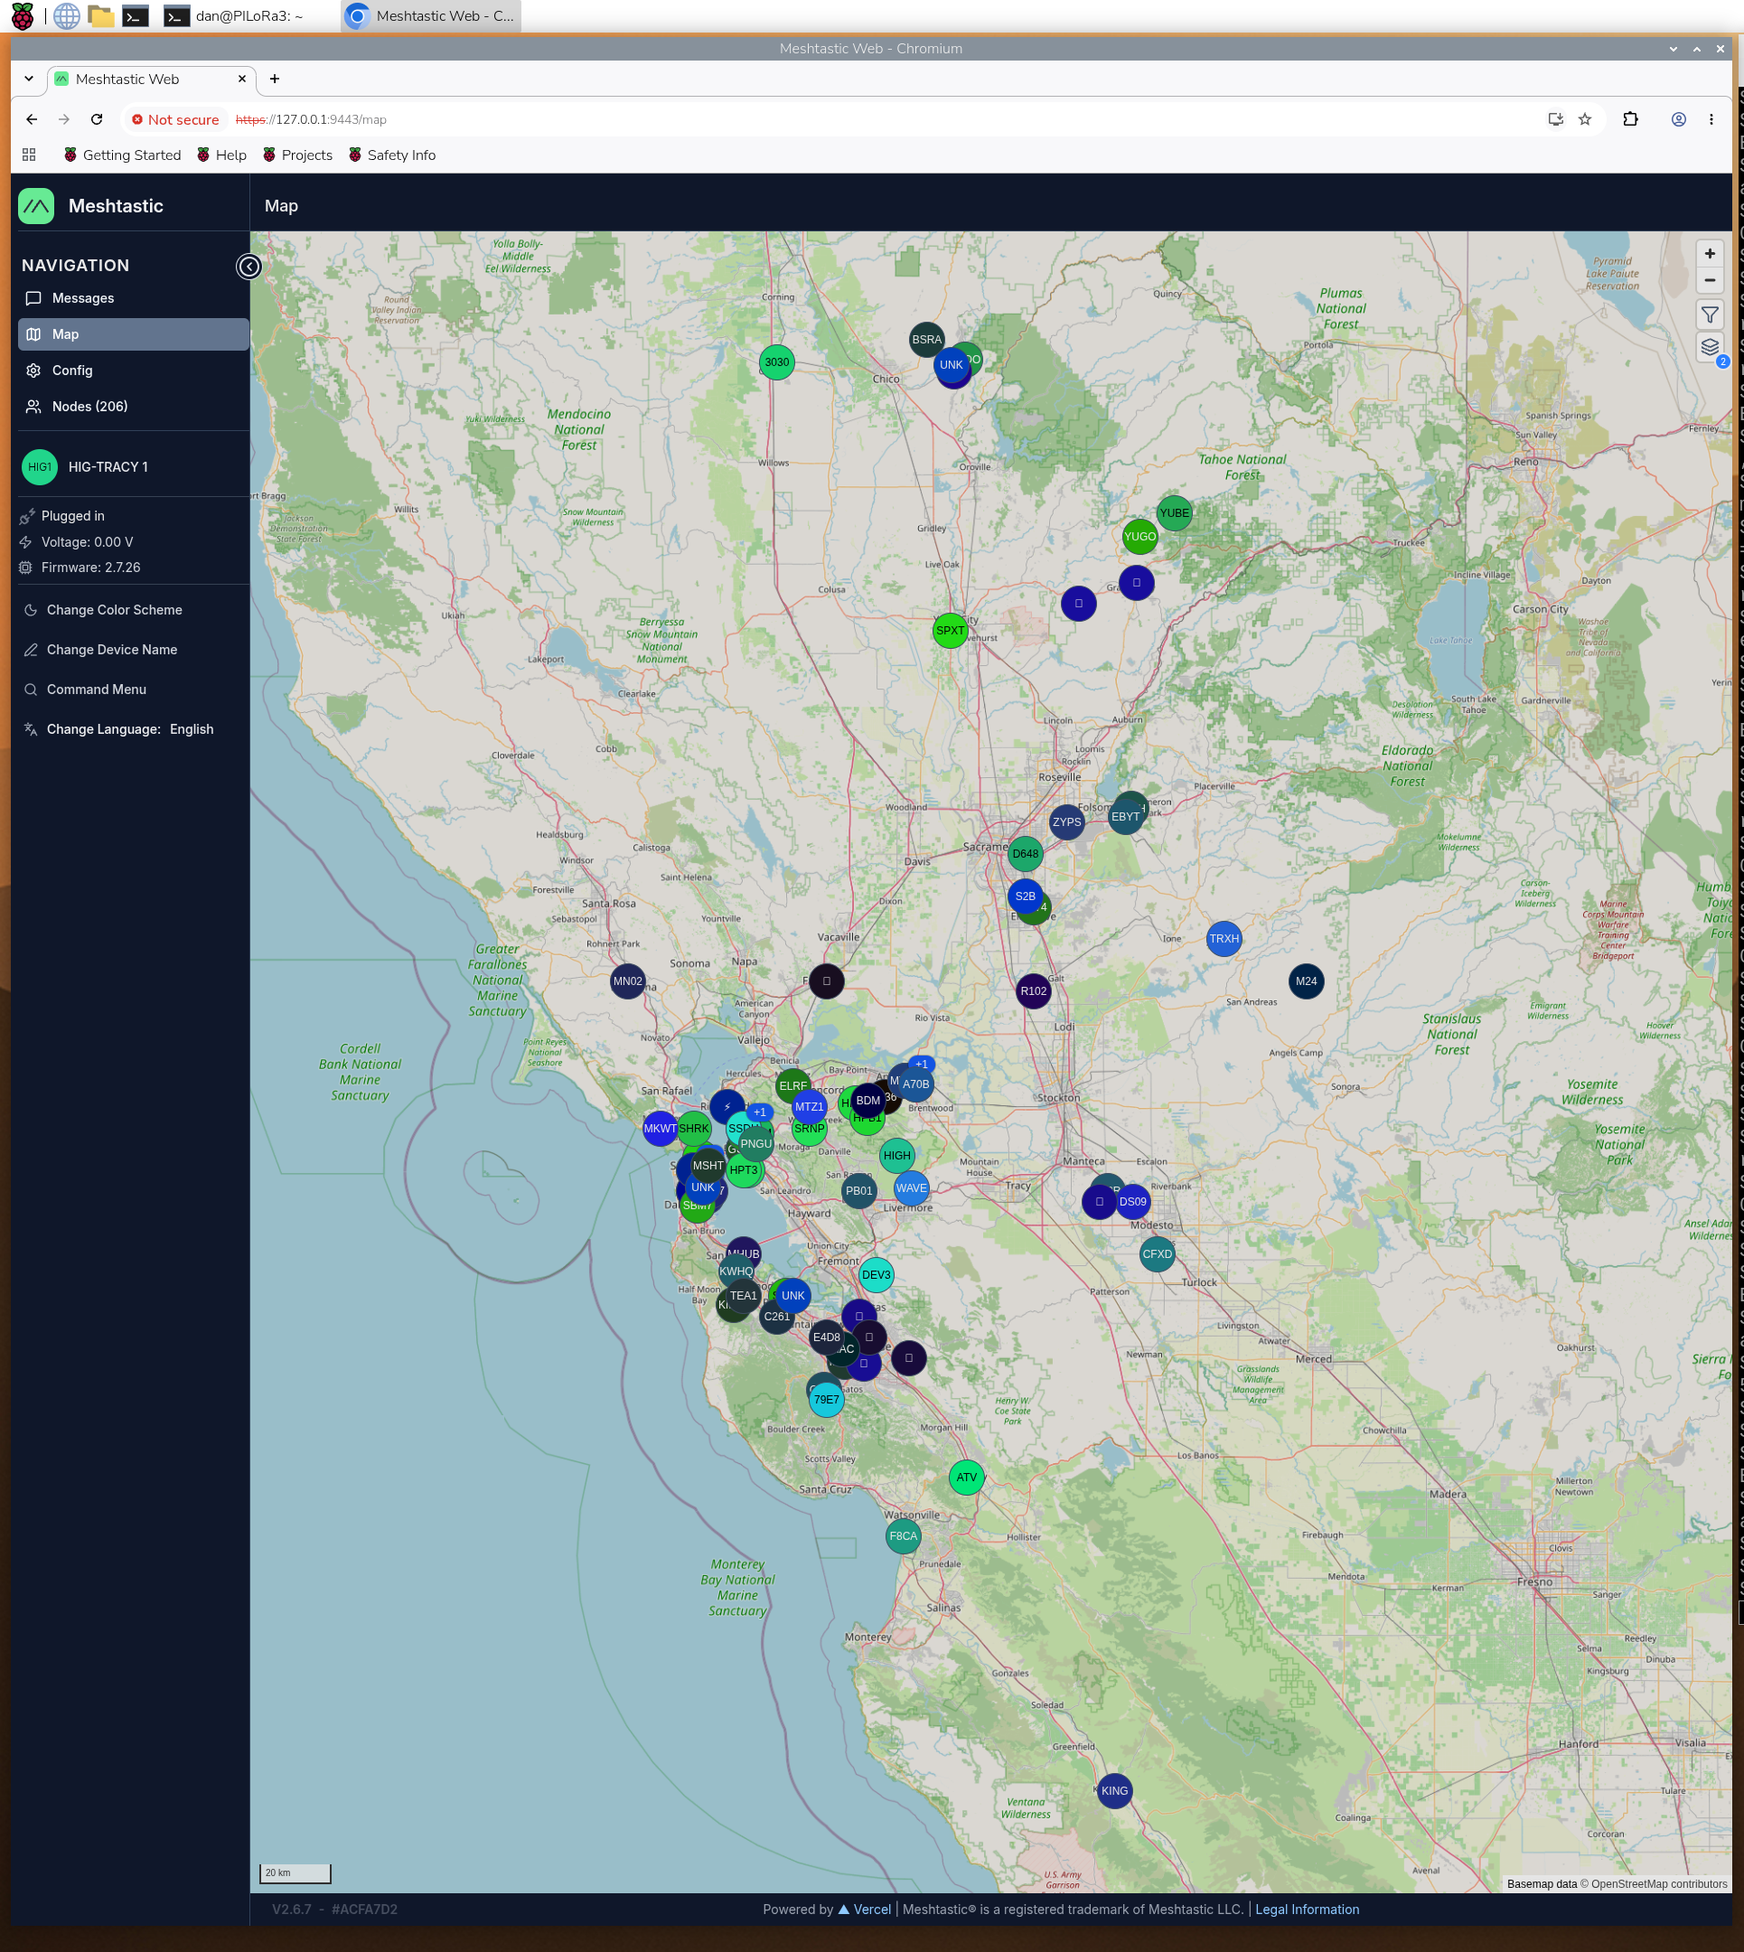
How is Meshtastic used for EmComm?
Meshtastic is used for emergency communication by creating a decentralized, off-grid text messaging and tracking network that operates completely independently of cellular towers and the internet

Slide 10
How it works in a disaster.
Mesh Relaying: Each device (called a node) both sends messages and automatically forwards messages for other nodes. If you are out of range of a recipient, intermediate nodes pass the text along like a digital bucket brigade.
No License Needed: Unlike amateur ham radio, Meshtastic operates on license-free radio bands (such as 915 MHz in the US), meaning anyone can turn a device on and use it immediately without testing or certification.
Smartphone Integration: Users typically connect a small pocket radio to their phone via Bluetooth. The phone acts as the keyboard and screen to type text messages and view maps, even though there is no cellular service.
GPS and Location Sharing: Many nodes feature built-in GPS, allowing groups to track each other's exact coordinates on a map in real time during a blackout or evacuation.
Low Power and Solar Friendly: Because the radios use very little power (LoRa technology), small solar-powered relay nodes can be mounted on roofs or high points to keep the regional emergency network alive for weeks during extended grid failures.

Slide 11
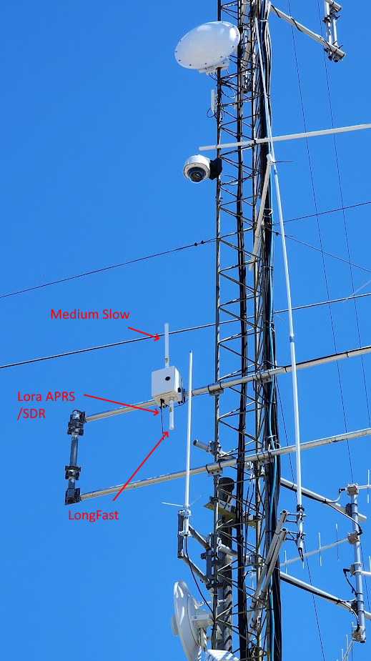
Local Information
mdarc.org/repeater-systems/meshtastic
BAYME.sh
sacValleyMesh.com

